Slide 1

Road Safety Matters : A survey on Knowledge Attitude and Practices among Students

Slide 2
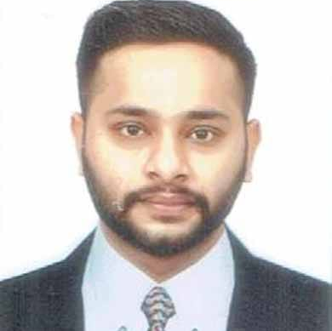



TEAM
Mr. Hannu Gandhi,
Panjab University , Chandigarh
Sapandeep Singh Sandhu,
Chandigarh University , Mohali
Ms. Poonam Rani
Eternal University, Baru Sahib, Himachal Pradesh
Miss Pooja Pagyal ,
Panjab University , Chandigarh

Slide 3
INTRODUCTION
Road accidents cost thousands of lives each year, creating a global threat with no demographic or geographic constraints. India has one of the greatest rates of road accident death tolls, making it critical to address this problem
According to the World Health Organization's (WHO) publication titled "The Global Status Report on Road Safety 2023," there are 1.19 million fatalities.
As reported by Road Accidents in India-2022, an estimated 4,61,312 road accidents occurred in India, which led to 1,68,491 deaths and 4,43,366 injuries. The statistics show an 11.9% year-on-year rise in accidents, a 9.4% increase in fatalities, and an enormous 15.3% jump in the number of people injured over the same period last year.

Slide 4

Purpose of the Survey
'Road Safety Matters,' was conducted to delve into people' awareness, attitudes, and practices concerning road safety, aiming to uncover crucial insights that could guide effective interventions.
Covering aspects from speed limit awareness to the understanding of the consequences of drink-driving, our study seeks to paint a comprehensive picture of people road safety knowledge

Slide 5
OBJECTIVE
Evaluate awareness of key road safety rules and regulations.
Assess the status and knowledge of road safety practices.
Gather information on the reasons behind traffic accidents.

Slide 6
Survey Execution
Collaboration with ICSSR:
This survey was conducted in collaboration with the ICSSR team lead by Mr Hannu, focusing on gathering crucial data on road safety awareness among students.
Targeted Demographic:
The survey targeted students, representing a crucial demographic for understanding emerging attitudes and practices towards road safety.

Slide 7
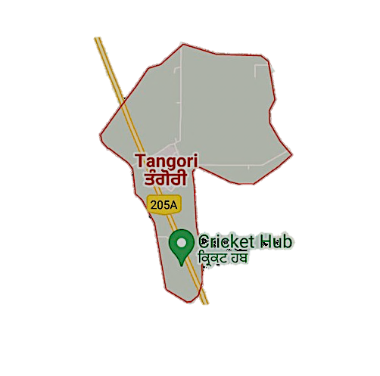
Location and Sample
Field Site: "The survey was carried out in Tangori Village(i.e. Block: kharar, District: SAS Nagar, State : Punjab), capturing insights from a community that reflects the broader population's perspectives on road safety.”
Population Representation: "With a total village population of 1,475, our sample of 50 students offers a window into the road safety knowledge and behaviors prevalent among young individuals in similar settings."

Slide 8



Data Collection
Selection Criteria: Students were chosen based on their grade level to ensure a focused understanding of road safety awareness at a critical age of becoming young road users.
Survey Methodology: A comprehensive survey was deployed, measuring key variables including Speed Limit Awareness (SL), Traffic Signals Recognized (TSR), and Use of Mobile Phone While Driving (M), among others, to gauge a broad spectrum of road safety attitudes and practices.

Slide 9
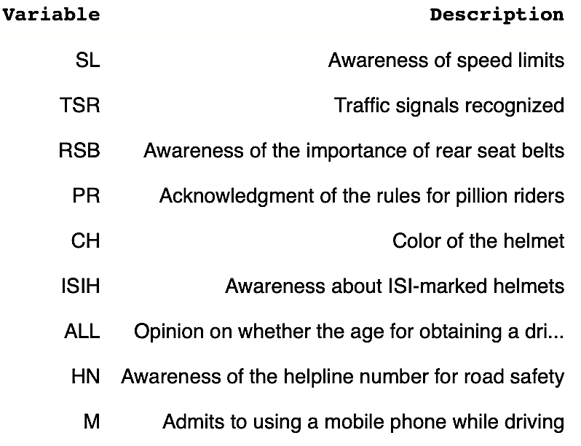
Key Variables Measured

Slide 10

Correlations and Insights
Insight 1: A positive correlation was observed between the awareness of speed limits (SL) and the recognition of traffic signals (TSR), suggesting that students who are aware of one are likely to be knowledgeable about the other.
Insight 2: However, a gap in safety practice awareness, particularly concerning rear seat belts (RSB), indicates a critical area for targeted educational programs.
Call to Action: These findings underline the importance of comprehensive road safety education, emphasizing not only knowledge of regulations but also the adoption of safe practices.

Slide 11
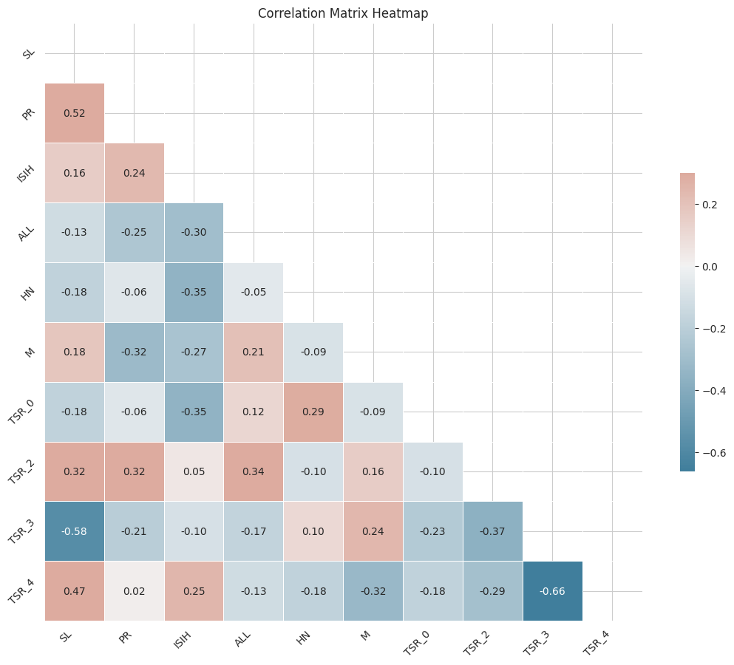
Correlation Analysis of Road Safety Awareness
Strong Positive Correlation between 'SL' and ‘PR’ :Map showed a correlation coefficient of 0.52 between Speed Limit Awareness ('SL') and Acknowledgment of the Rules for Pillion Riders ('PR'), this indicates a strong positive relationship, suggesting that students aware of speed limits are likely also aware of pillion rider rules.
Moderate Positive Correlation between 'TSR' and 'ISIH’:A coefficient of avg 0.47 between Traffic Signals Recognized ('TSR') and Awareness About ISI Marked Helmet ('ISIH') would suggest a moderate positive correlation. Students who recognize more traffic signals tend to be more aware of the importance of ISI-marked helmets.

Slide 12
Correlation Analysis of Road Safety Awareness
Low or No Correlation between 'RSB' and 'ALL':A coefficient close to 0, say 0.1, between Awareness of the Importance of Rear Seat Belts ('RSB') and Opinion on Lowering Age for Driving License ('ALL'), would indicate a weak or no linear relationship. Awareness of rear seat belt importance doesn't strongly relate to opinions on driving license age requirements.
Negative Correlation between 'M' and 'SL’ :If the heatmap indicated a negative correlation, for example, -0.3 between Use of Mobile Phone While Driving ('M') and Speed Limit Awareness ('SL'), it would suggest that as the tendency to use a mobile phone while driving increases, awareness of speed limits slightly decreases.

Slide 13
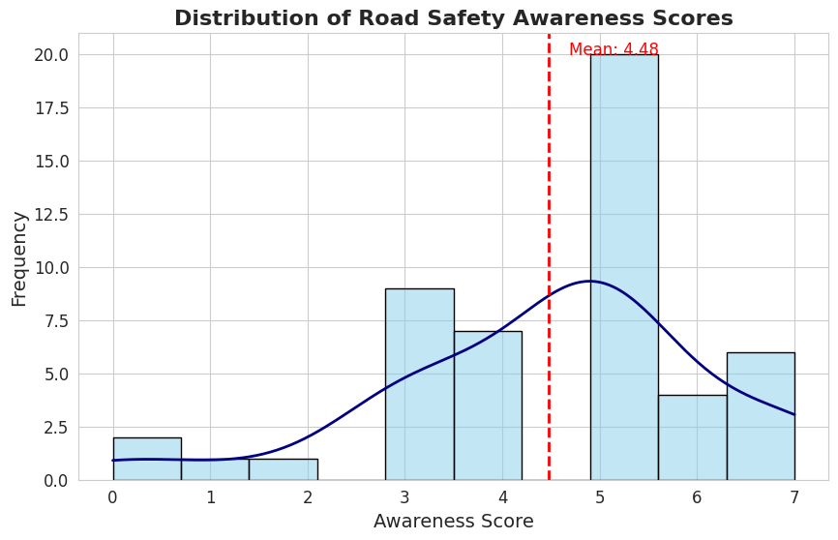
Scores of Road Safety Awareness
Central Tendency: The mean awareness score is marked by the red dashed line, which indicates that the average road safety awareness score among students is 4.48. This suggests a moderate level of awareness overall.
Most Frequent Score: The tallest bar represents the awareness score that the most students received. In this case, it's a score of 4, which implies that this score is the most common among the students surveyed.
Score Range: The x-axis displays awareness scores ranging from 0 to 7. Few students have very low or very high scores, as seen by the shorter bars at the ends of the x-axis.

Slide 14
Scores of Road Safety Awareness
Skewness: There appears to be a slight left skew in the distribution as there is a tail extending towards the lower scores. This suggests that while many students have a moderate level of awareness, a smaller group has a significantly lower level of awareness.
Score Distribution: The distribution of scores, as illustrated by the KDE curve[1], shows a concentration around the mean with a gradual fall off towards the higher and lower scores. This indicates that most students' awareness levels are clustered around the mean.

Slide 15
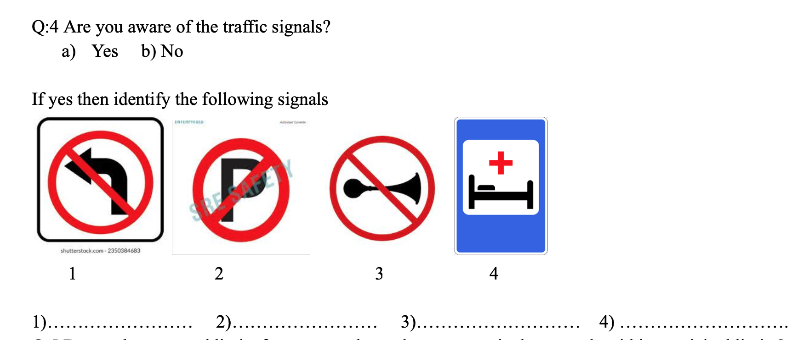
Knowledge Gaps & Educational Insights
Knowledge Gaps
A segment of students failed to identify any traffic signs.
Reveals significant educational gaps in road safety.
Educational Insights
The least recognized signals point to areas needing targeted educational efforts.
The data can guide road safety educators to focus on the signals that students are least aware of.
Educational initiatives should aim to bridge knowledge gaps to enhance overall road safety comprehension.

Slide 16
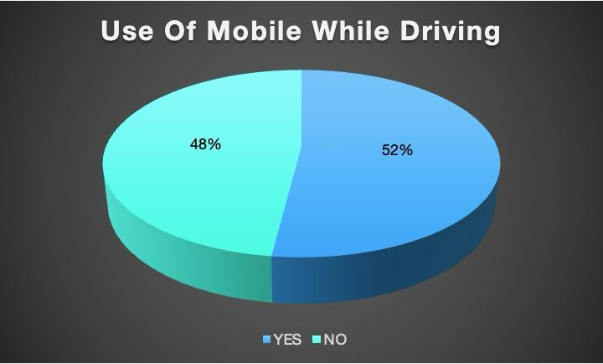
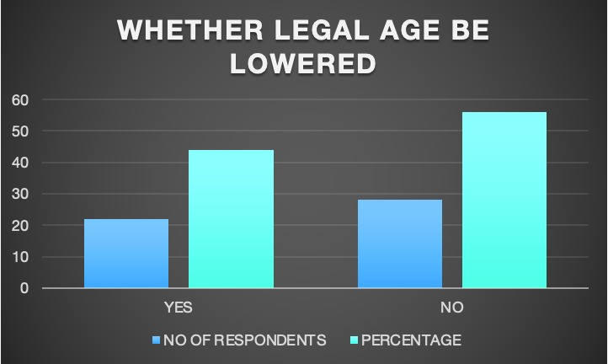
Analysis of Current Road Safety Practices Among Students
Overview of Practice Variables:
Briefly describe each variable:
SL (Speed Limit Awareness): Assesses whether students are aware of speed limits.
PR (Pillion Riders): Evaluates student knowledge of rules for pillion riders on motorcycles.
ISIH (ISI Helmets): Determines if students understand the importance of ISI-certified helmets.
M (Mobile Usage): Examines the prevalence of mobile phone usage while driving among students.
ALL (Driving Age): Gathers student opinions on whether the legal driving age should be lowered.

Slide 17

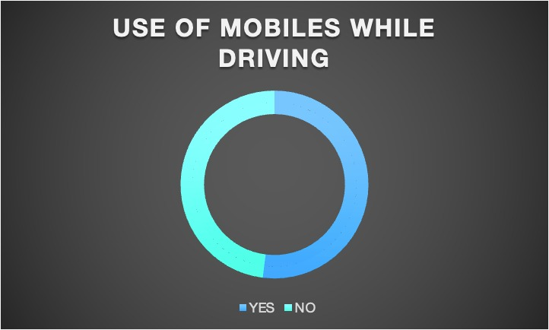
Analysis of Current Road Safety Practices Among Students
Use of Cell Phone While Driving (M)
Influence on Speed Limit Awareness (SL): The regression might show a negative coefficient for 'M', indicating an inverse relationship; students who admit to using cell phones while driving could be less aware of speed limits. Or conversely, if positive, it might indicate that those who are aware of speed limits are also more conscious of the dangers of cell phone use while driving.

Slide 18
Analysis of Current Road Safety Practices Among Students
Opinions on Lowering the Age for Driving License (ALL):
Correlation with SL: Depending on the coefficient, explain how students' opinions on age requirements for driving licenses correlate with their awareness of speed limits. A non-significant coefficient could suggest no clear relationship, while a significant one would imply that attitudes toward age requirements might reflect broader safety awareness.

Slide 19
Analysis of Current Road Safety Practices Among Students
Helmet Safety Standards
Pillion Riding Rules Knowledge
Mobile Phone Usage
Comprehensive Awareness
Pillion Riding Rules Knowledge: Awareness of pillion riding rules (PR) is a strong predictor of speed limit awareness (SL), emphasizing the importance of motorcycle safety in educational content.
Helmet Safety Standards: Knowledge about ISI helmet standards (ISIH) is moderately associated with speed limit awareness, reinforcing the need for education on protective gear.
Cell Phone Usage: The relationship between cell phone usage while driving (M) and speed limit awareness varies, indicating complexities in behavior that require further research.
Legal Age Awareness: Opinions on legal driving age (ALL) show no strong correlation with speed limit awareness, suggesting this belief may be independent of specific road rule knowledge.

Slide 20
Analysis of Current Road Safety Practices Among Students
Helmet Safety Standards
Pillion Riding Rules Knowledge
Mobile Phone Usage
Comprehensive Awareness
Comprehensive Awareness: Students with high awareness in one road safety area tend to show awareness in others, suggesting benefits to an integrated educational approach.
Significant Relationships: Key variables like 'PR' and 'M' significantly predict speed limit awareness, guiding where to focus road safety education for the greatest impact.
Actionable Insights: The regression findings offer actionable insights for tailoring road safety education to address gaps and leverage the interconnectedness of different safety knowledge areas

Slide 21
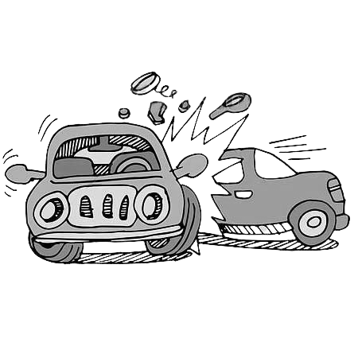
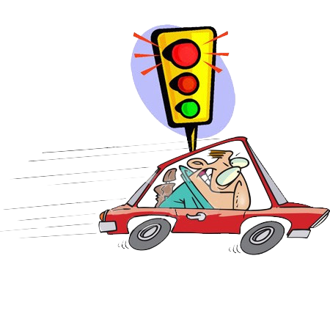
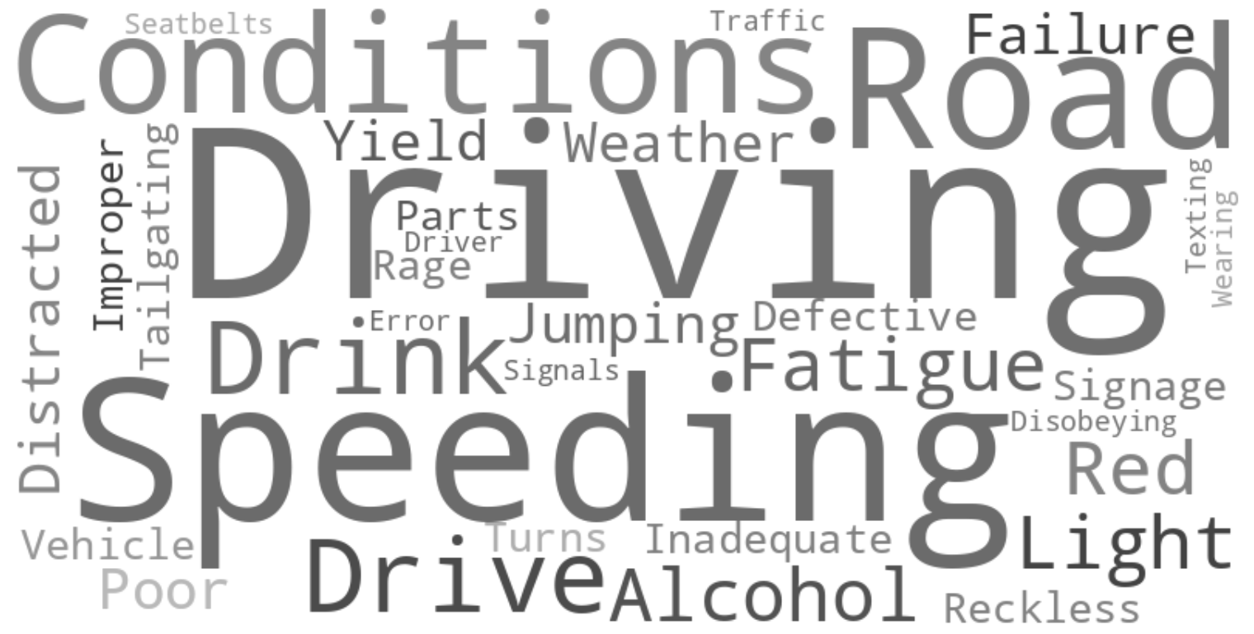
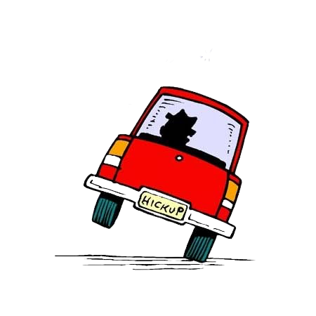
Reasons Behind Traffic Accidents

Slide 22
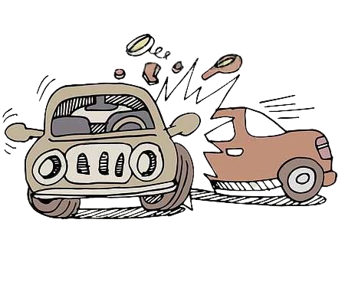
Reasons Behind Traffic Accidents
Drinking and Driving: A significant factor in traffic accidents, impairing judgment and reaction times, and leading to poor decision-making on the road.
Over Speeding: Contributes to a substantial number of accidents due to reduced control and increased severity of crashes.
Fatigue: Often overlooked, drowsy driving can be as dangerous as driving under the influence, leading to a delayed response to traffic conditions.
Alcohol: Even small amounts can affect driving ability, with alcohol-related accidents being highly preventable yet tragically common.
Red Light Jumping: Indicates a disregard for traffic laws and significantly raises the risk of intersection collisions.

Slide 23
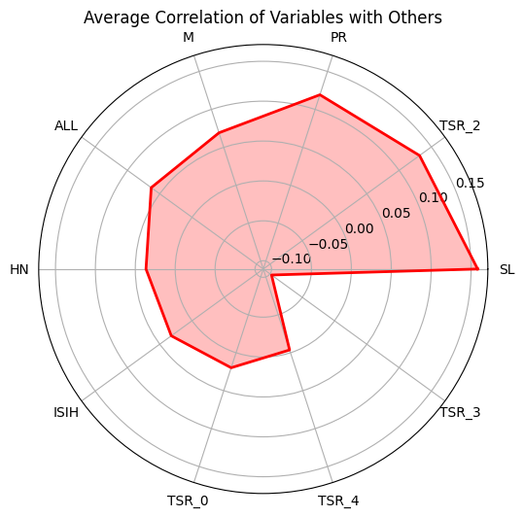
Implications for Student Safety and Awareness:
Risk Perception: These causes highlight the need to enhance students' perception of risk associated with certain behaviors, like fatigue and alcohol consumption.
Educational Programs: Reinforce the dangers of speeding and red light jumping in driver's education and general road safety campaigns aimed at students.
Policy and Enforcement: Advocate for strict enforcement of drunk-driving laws and emphasize the personal and legal consequences of such actions.
Community Involvement: Encourage community-driven initiatives to raise awareness about these risks, especially in settings frequented by students.

Slide 24
Survey Findings:
Variable Awareness Levels: Students displayed varying levels of awareness on different road safety topics, indicating the need for more comprehensive safety education programs.
Critical Knowledge Gaps: Specific areas such as the importance of rear seat belts and traffic signal recognition showed lower awareness, pointing to critical knowledge gaps.
Positive Associations: Students aware of certain road safety aspects, like helmet standards, tend to be informed about other safety measures as well, suggesting that knowledge in one area may reinforce another.

Slide 25
Educational Implications:
Curriculum Enhancement: Integrate road safety topics with lower awareness into the existing curriculum to ensure all aspects are covered uniformly.
Interactive Learning: Incorporate interactive elements, such as simulations and practical demonstrations, to improve traffic signal recognition and the importance of seat belt use.
Peer Education: Encourage peer-to-peer education programs where students can share their knowledge and experiences regarding road safety.

Slide 26
Policy Implications:
Enforcement of Safety Practices: Strengthen the enforcement of road safety laws, particularly those regarding seat belt use and mobile phone restrictions while driving.
Community Engagement: Involve local communities in road safety campaigns, focusing on areas where students have shown lower awareness.
Continuous Assessment: Implement ongoing assessment strategies to monitor and evaluate the effectiveness of road safety education.

Slide 27
Recommendations
Enhancing Road Safety Awareness:
Targeted Road Safety Education: Develop and implement targeted educational programs that address identified gaps, such as the use of rear seat belts and traffic signal recognition.
Engagement Through Technology: Leverage apps and virtual reality experiences to engage students in road safety scenarios, enhancing their understanding and retention of road safety rules.
Parental Involvement: Encourage parents to discuss road safety at home and to model safe behaviour, including the use of seat belts and helmets.

Slide 28
Conclusion
Reinforcing Road Safety Education:
Lifelong Impact: Emphasize that road safety education is not just a curriculum component, but a lifelong learning process with a significant impact on student safety and community well-being.
Cultural Shift: Highlight the need for a cultural shift towards road safety, where adherence to rules becomes a shared value within the student community and beyond.
Continuous Effort: Stress the importance of continuous and evolving educational efforts that adapt to changes in traffic laws, technology, and student experiences.

Slide 29

Q&A Any Query?

Slide 30
[1] https://en.wikipedia.org/wiki/Kernel_density_estimation
[2] https://morth.nic.in/road-safety
[3]https://morth.nic.in
[4] https://www.mygov.in/campaigns/national-road-safety/
[5] https://indiairf.com
[6] https://www.safeindia.ngo/road-safety

